Slide 1
Presentation on
Measurement Instruments: Slotted Line and Tunable Detector
By: Gaurav Vijay Topre (10303320181137210017)
Subject : Microwave Theory and Techniques

Slide 2
Contents
This presentation consists of
Introduction to Microwave Bench Measurement
Setup of Microwave Bench General Measurement
Slotted Line
Tunable Detector
Advantages of using this Technique
References

Slide 3
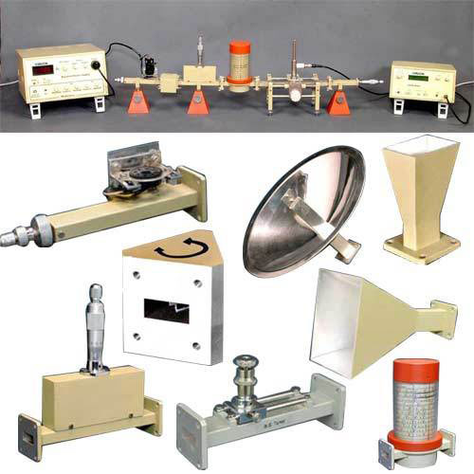
Introduction
Among the Microwave measurement devices, a setup of Microwave bench, which consists of Microwave devices has a prominent place. This whole setup, with few alternations, is able to measure many values like guide wavelength, free space wavelength, cut-off wavelength, impedance, frequency, VSWR, Klystron characteristics, Gunn diode characteristics, power measurements, etc.
The output produced by microwaves, in determining power is generally of a little value. They vary with the position in a transmission line. There should be an equipment to measure the Microwave power, which in general will be a Microwave bench setup.

Slide 4
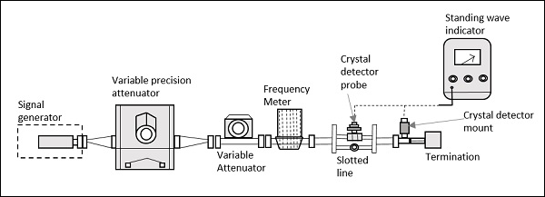
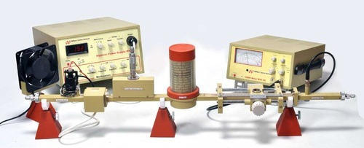
SETUP OF
BENCH MEASUREMENT
TECHNIQUE
Fig: Setup of Microwave Bench Measurement

Slide 5
Signal Generator
Frequency Meter
Generating signals in milliwatts
E.g Gunn diode oscillator or a Reflex Klystron tube
the signal can be adjusted to its resonance frequency using this
provision to couple the signal to waveguide
Precision Attenuator
Crystal Detector
Select Desirable Frequency
Confines the o/p in range 0 to 50db
used to demodulate the signals
Variable Attenuator
Standing Wave Indicator
This sets amount of attenuations
provides the reading of standing wave ratio in dB
Isolator
Removes signal that is not required

Slide 6
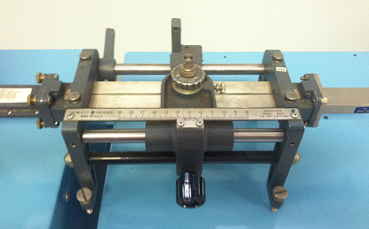
SLOTTED LINE
A slotted line carriage is a microwave instrument which is used to measure:
• Wavelength
• Voltage Standing Wave Ratio (VSWR) and standing wave pattern
• Impedance, reflection coefficient and return loss measurement

Slide 7
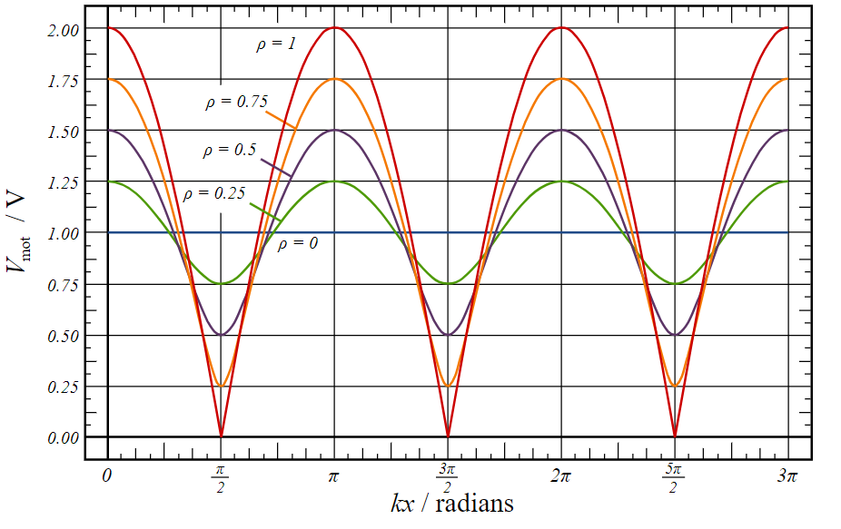
• It has a coaxial E-field probe which penetrates inside a rectangular waveguides slotted in sections from the outer wall.
• The probe is able to transverse a longitudinal narrow slot and locate the standing waves maxima(Vmax) and minima (Vmin) along the line giving VSWR.
Construction:
The slotted line consists of a slotted section of a transmission line, where the measurement has to be done. It has a travelling probe carriage, to let the probe get connected wherever necessary, and the facility for attaching and detecting the instrument.
In a waveguide, a slot is made at the center of the broad side, axially. A movable probe connected to a crystal detector is inserted into the slot of the waveguide.
Fig: Standing wave patterns on a line for various reflection coefficients showing maxima and minima

Slide 8
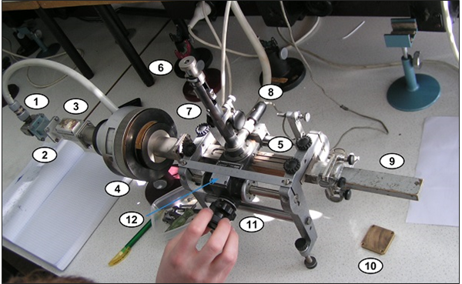
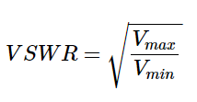
Operation
The output of the crystal detector is proportional to the square of the input voltage applied. The movable probe permits convenient and accurate measurement at its position. But, as the probe is moved along, its output is proportional to the standing wave pattern, which is formed inside the waveguide. A variable attenuator is employed here to obtain accurate results.
Output VSWR can be obtained by equation
Parts labelled in figure are as follows
1. Launcher − Invites the signal.
2. Smaller section of the waveguide.
3. Isolator − Prevents reflections to the source.
4. Rotary variable attenuator − For fine adjustments.
5. Slotted section − To measure the signal 6. Probe depth adjustment.
7. Tuning adjustments − To obtain accuracy.
8. Crystal detector − Detects the signal.
9. Matched load − Absorbs the power exited.
10 Short circuit − Provision to get replaced by a load.
11. Rotary knob − To adjust while measuring.
12. Vernier gauge − For accurate results.

Slide 9
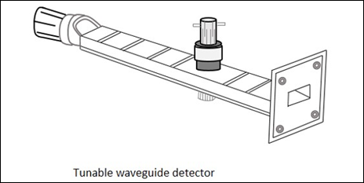
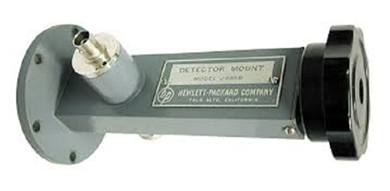
TUNABLE DETECTOR
The tunable detector is a detector mount which is used to detect the low frequency square wave modulated microwave signals. The Above figure gives an idea of a tunable detector mount.
The above image represents the practical application of this device. It is terminated at the end and has an opening at the other end just as the above one.

Slide 10
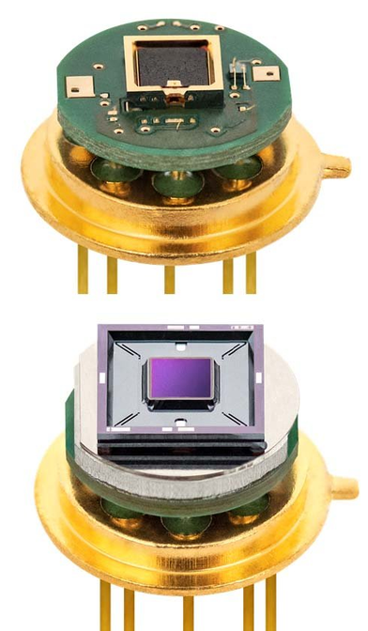
To provide a match between the Microwave transmission system and the detector mount, a tunable stub is often used. There are three different types of tunable stubs.
Tunable waveguide detector
Tunable co-axial detector
Tunable probe detector
Also, there are fixed stubs like −
Fixed broad band tuned probe
Fixed waveguide matched detector mount
fig:
Photographs of the tunable detector module in a TO39 package

Slide 11
https://www.tutorialspoint.com/microwave_engineering/microwave_engineering_measurement_devices.html
Das & Das, page 496, Voltmer, page 147
Tunable Compact Probing Detector with Fast Analysis Time Against Invasive Attacks[IEEE Paper]
REFERENCES

